Slide 1
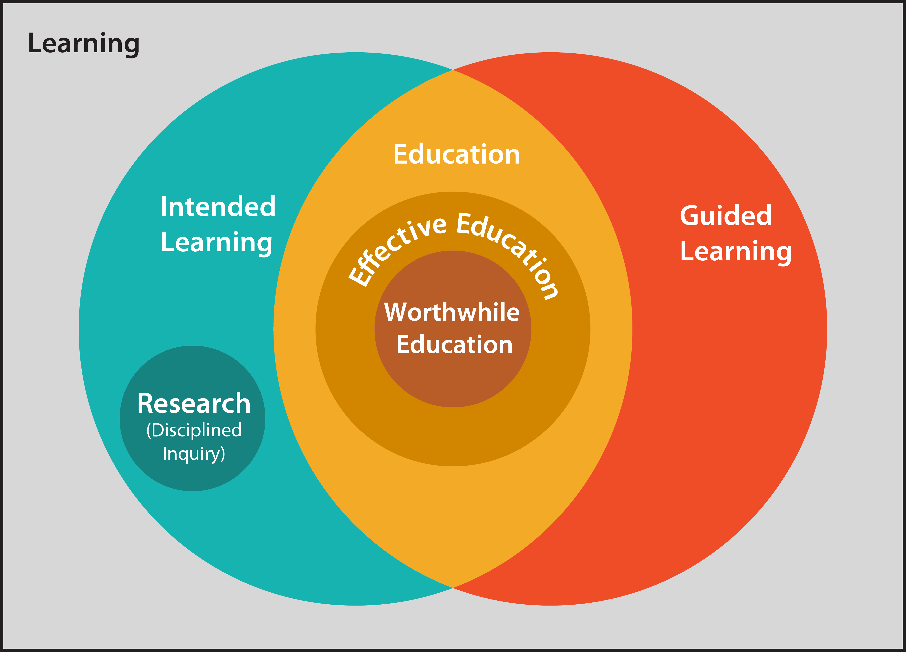
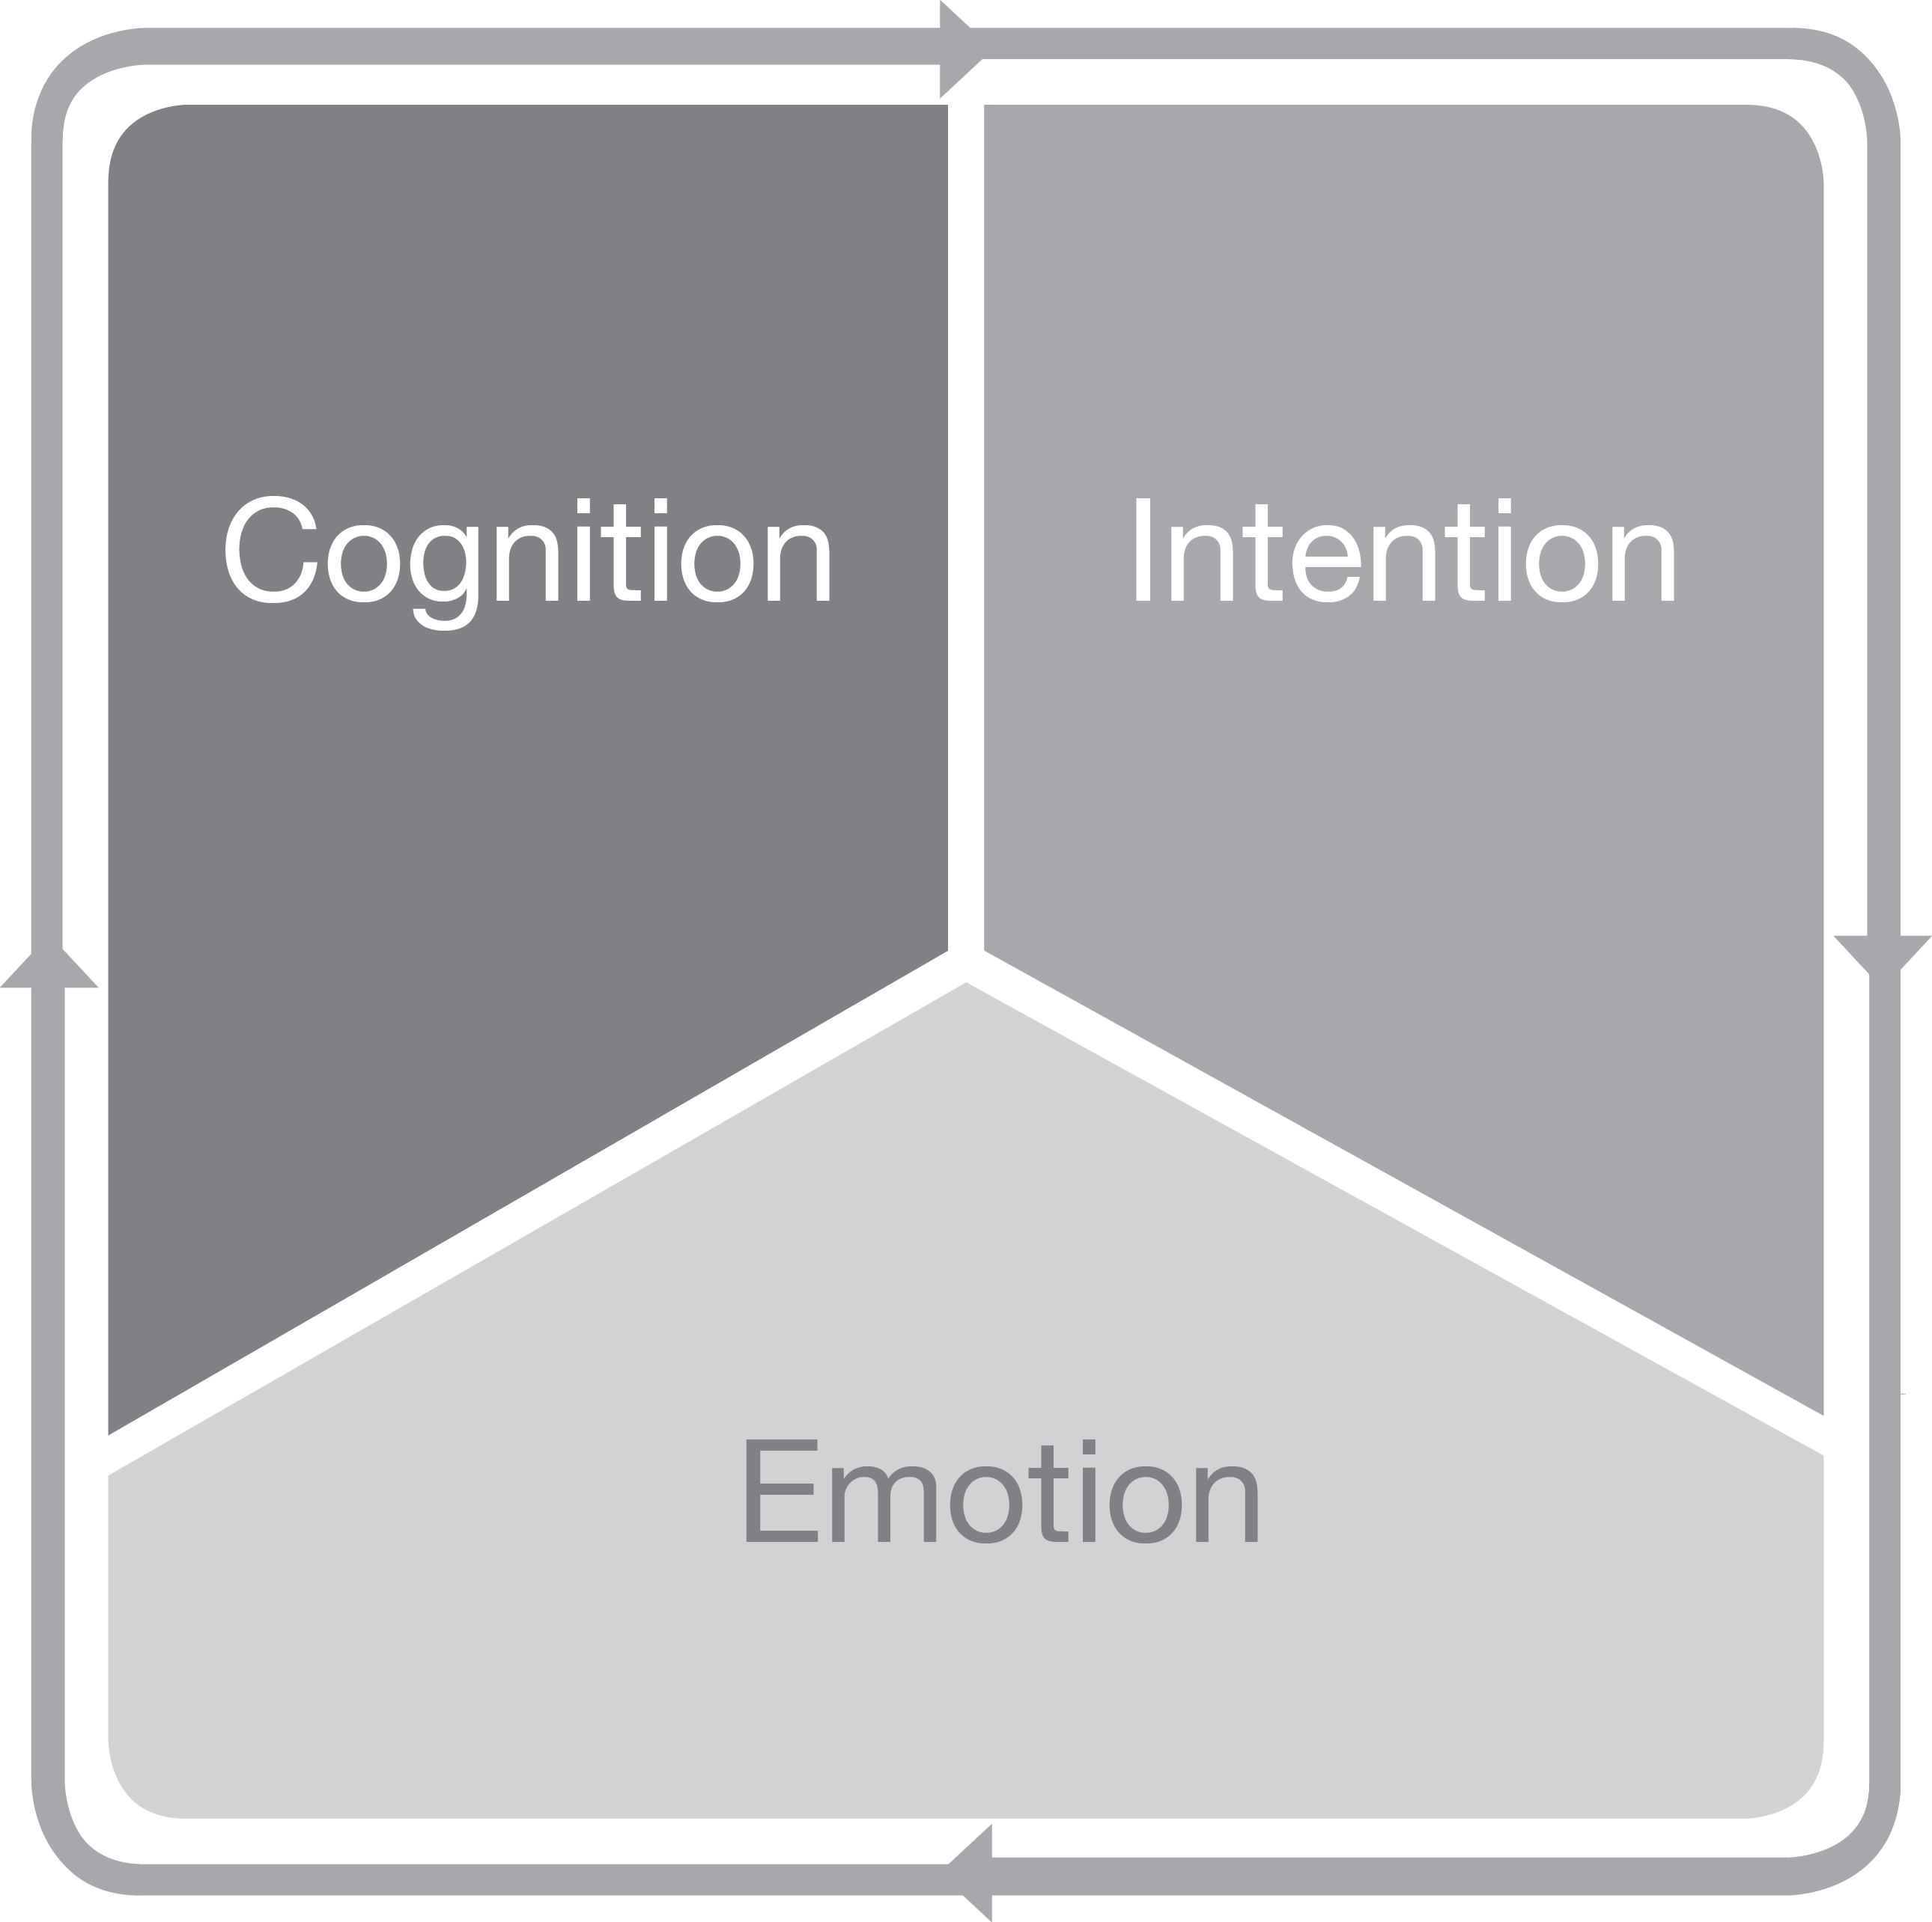
A Vision for Systemic Change: The Theory of Totally Integrated Education
+
Theodore W. Frick, November 11, 2011

Slide 2
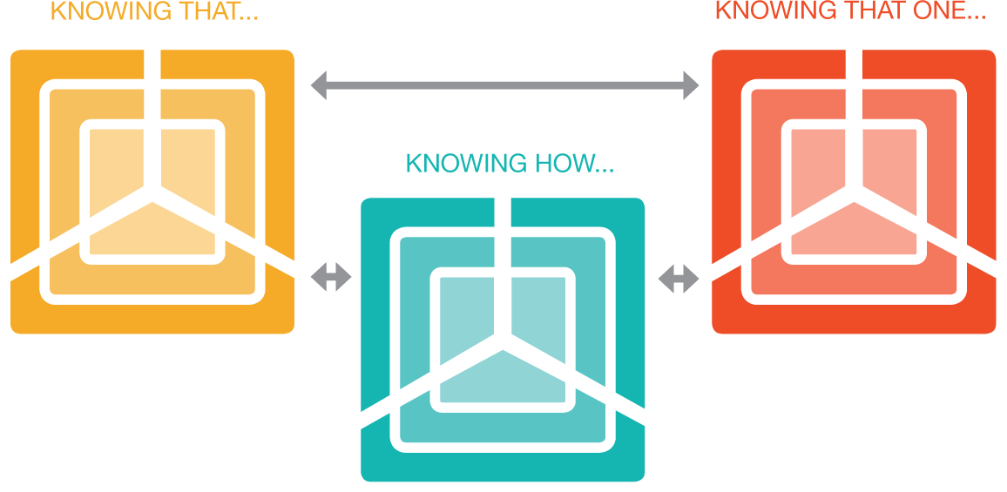
TIE: Totally Integrated Education
Connecting cognition, intention and emotion with
9 kinds of worthwhile learning outcomes—27 connections

Slide 3
TIE Theory provides a vision for systemic change in education.
Not how to do it, but what to aim for.

Slide 4
TIE theory provides a vision for creating worthwhile education. TIE theory further provides a rationale for these aims.
Fundamental to TIE is the notion of aligning student cognition, intention and emotion with authentic learning tasks.
When this is done well, student learning is predicted to be more flexible and whole, and less vulnerable to forgetting.

Slide 5
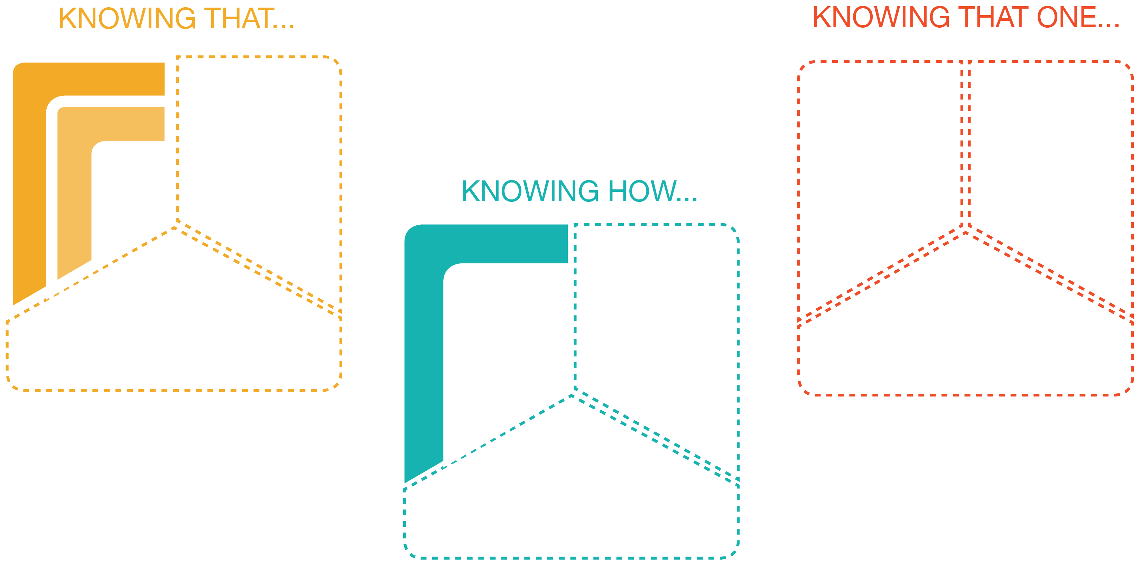
Typical Learning Outcomes
In Current Education System
Learning Outcomes
Envisioned by
TIE Theory

Slide 6
We should seek worthwhile education
which is totally integrated

Slide 7
Overview
Importance of alignment of cognition, intention and emotion
Completely connected kinds of knowing
Distinctions among learning, education, effective education, and worthwhile education
Need for task-centered vs. topic-centered curriculum development
Retroduction for TIE theory development

Slide 8
Connecting Cognition, Intention and Emotion

Slide 9
Importance of connecting cognition, intention and emotion
Dewey (1916): meaningful experience and thinking
  “Thinking, in other words, is the intentional endeavor to discover specific connections between something we do and the consequences which result…” (p. 145, italics added)
  “Experience as trying involves change, but change is meaningless transition unless it is consciously connected with the return wave of consequences which flow from it. When an activity is continued into the undergoing of consequences, when the change made by action is reflected back into the change made in us, the mere flux is loaded with significance. We learn something.” (p. 139, italics added)

Slide 10
Importance of connecting cognition, intention and emotion (cont’d)
Greenspan & Benderly (1997): emotion is the architect of mental structures
  “In fact, emotions, not cognitive stimulation, serve as the mind’s primary architect” (p. 1).
  They identify the importance of emotion during human experience: “… each sensation … also gives rise to an affect or emotion…. It is this dual coding of experience that is the key to understanding how emotions organize intellectual capacities …” (p. 18).

Slide 11
Importance of connecting cognition, intention and emotion (cont’d)
Goleman (2011): emotional intelligence
  “When we have a thought it’s immediately valenced by these brain centers, positive or negative.”
  Goleman is referring to “… emotional centers in the midbrain, interacting with a specific area in the prefrontal cortex” [Kindle location 116].

Slide 12
Yet, what is happening in schools today
Results from a survey of 81,499 students in 110 high schools across 26 U.S. states (Yazzie-Mintz, 2007):
  Approximately 2 out of 3 students said that they were bored in class every day.
  Top reasons were that learning materials were uninteresting, irrelevant and not challenging enough. E.g., students said:
    “Our school needs to be more challenging. Students fall asleep because the classes aren’t really that interesting.”
    “School is easy. But too boring. Harder work or more is not the answer though. More interesting work would be nice” (p. 10).

Slide 13
Lack of integration of cognition with emotion and intention
Too often students are expected to engage with content they really do not want to learn
nor do they feel good about it. Cognition is disconnected with intention and emotion.

Slide 14
Lack of integration of cognition with emotion and intention: TIE theory predicts:
To focus only on student cognitive development at the expense of intention and emotion will result in weaker or disconnected mental schema.
Such schema will lack wholeness and hence would be poorly integrated into existing mental structures, much like an uninvited guest at a party who stands in the corner of the room and does not interact with other invited guests.
If students do make cognitive gains, but they are indifferent or have negative feelings about the learning experience, then such schema would be more vulnerable to forgetting due to lack of integration.

Slide 15
On the other hand, complete connectedness occurs during learning tasks when:
Cognition: S comes to know X.
Intention: S intends to learn X.
Emotion: S feels good about learning X.
  Where S represents the student, and
  X represents the 9 kinds of connected learning outcomes: instantial, relational, criterial, imitative, adaptive, creative, recognitive, acquaintive, and appreciative.

Slide 16
Connecting cognition, intention and emotion is represented by this diagram:

Slide 17
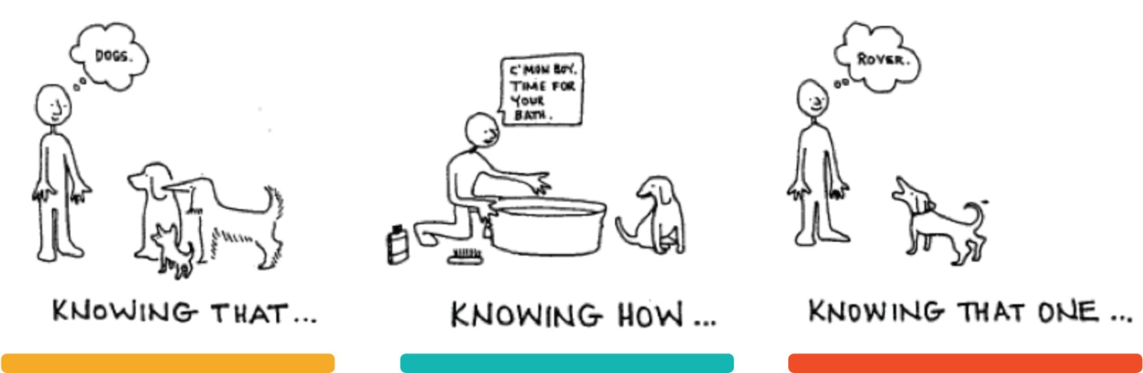
There are three basic kinds of cognitive learning outcomes (Maccia, 1987; Frick, 1997):

Slide 18
Completely-connected learning outcomes where cognition, intention and emotion are aligned with knowing that, knowing how and knowing that one

Slide 19
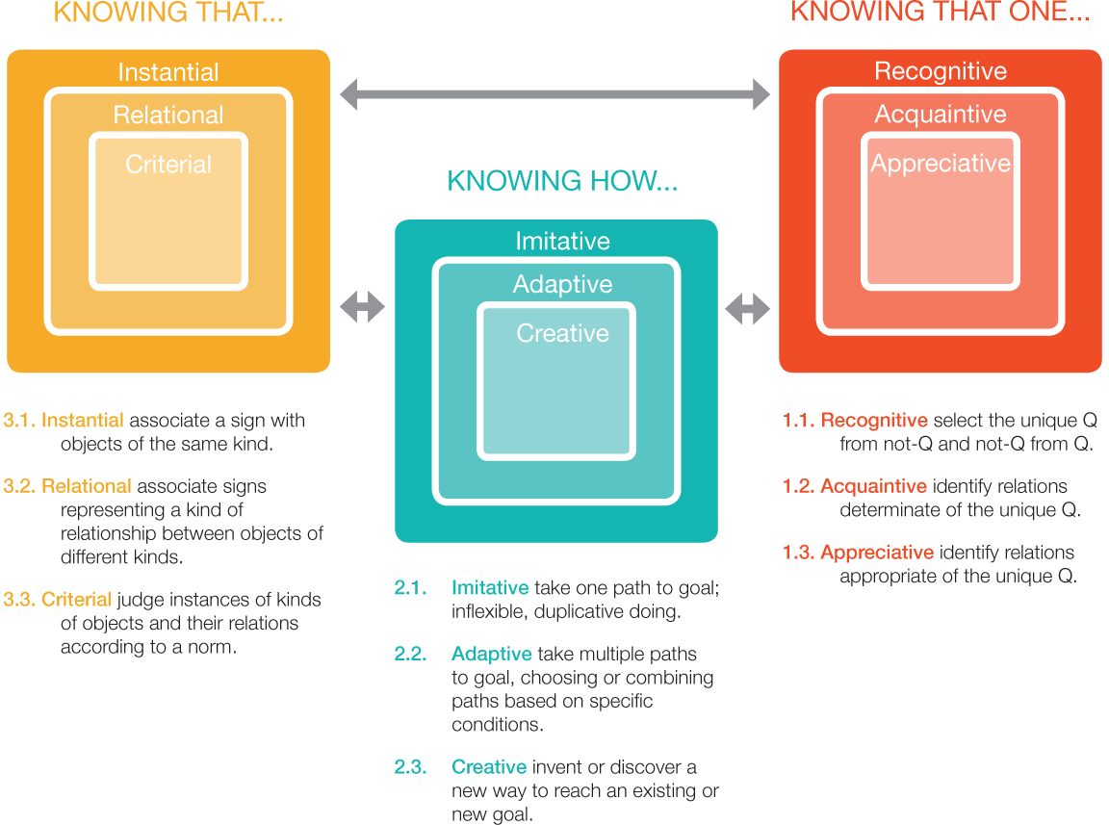
Nine specific types of learning outcomes:

Slide 20
TIE theory predicts that when cognition, intention and emotion are completely connected with 9 types of learning outcomes (27 connections total), then vulnerability to forgetting is minimized.

Slide 21
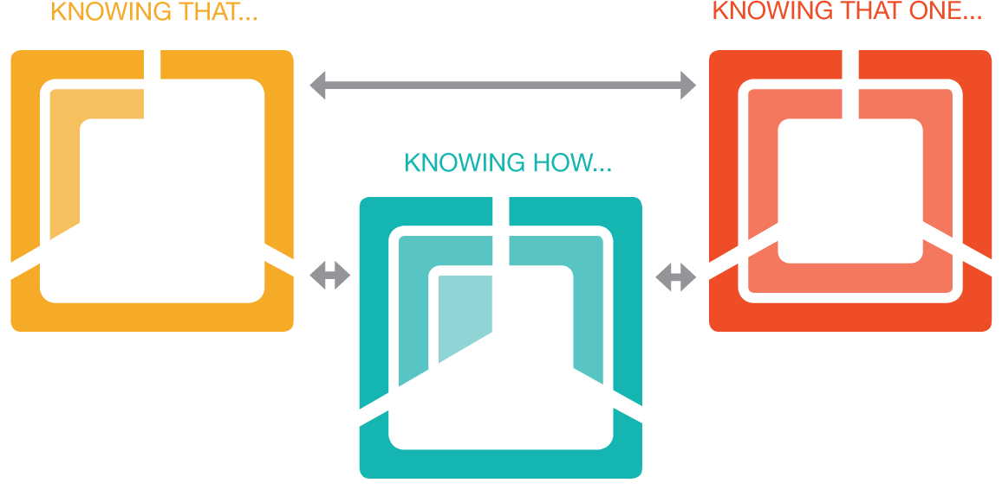
Partially connected learning outcomes: Note the empty areas which indicate missing connections

Slide 22
Typical learning outcomes in school: Note that know that one is missing and not connected to know that or how; know how and that are disconnected; intention and emotion are missing everywhere.

Slide 23
TIE Theorem
What is learned (X) will be less vulnerable to forgetting (because mental structures are stronger and more flexible) when
  Cognition, intention and emotion are aligned (S comes to know X; S intends to learn X; S feels good about learning X)
  AND
  Nine kinds of learning tasks are integrated (knowing that, knowing how, and knowing that-one)
  AND
  Learning tasks mastered by students are authentic and whole.

Slide 24
For each educational objective or standard, fully integrated learning outcomes are depicted below.

Slide 25
Definitions in TIE Theory
Learning, education, effective education, worthwhile education

Slide 26
Learning: increasing complexity of mental structure
Mental structure: affect-relations (schema) which constitute a person’s intelligence
Complexity: number of connections among components of a system (Thompson, 2008a; 2008b)
Increasing complexity: more connections than before
Consistent with empirical findings in neuroscience by Nobel Prize winner Eric Kandel (1989):
  long-term memory is “associated with growth in synaptic connections [among neurons]” (p. 115), and that “learning produces enduring changes in structure and function of synapses” (p. 121).
Greenspan & Shanker (2004): emotion and intention determine these structures through dual coding of experience

Slide 27
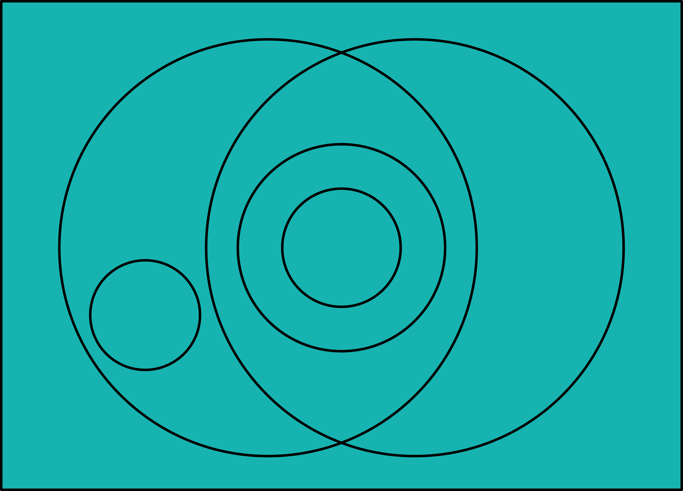
Learning: all kinds

Slide 28
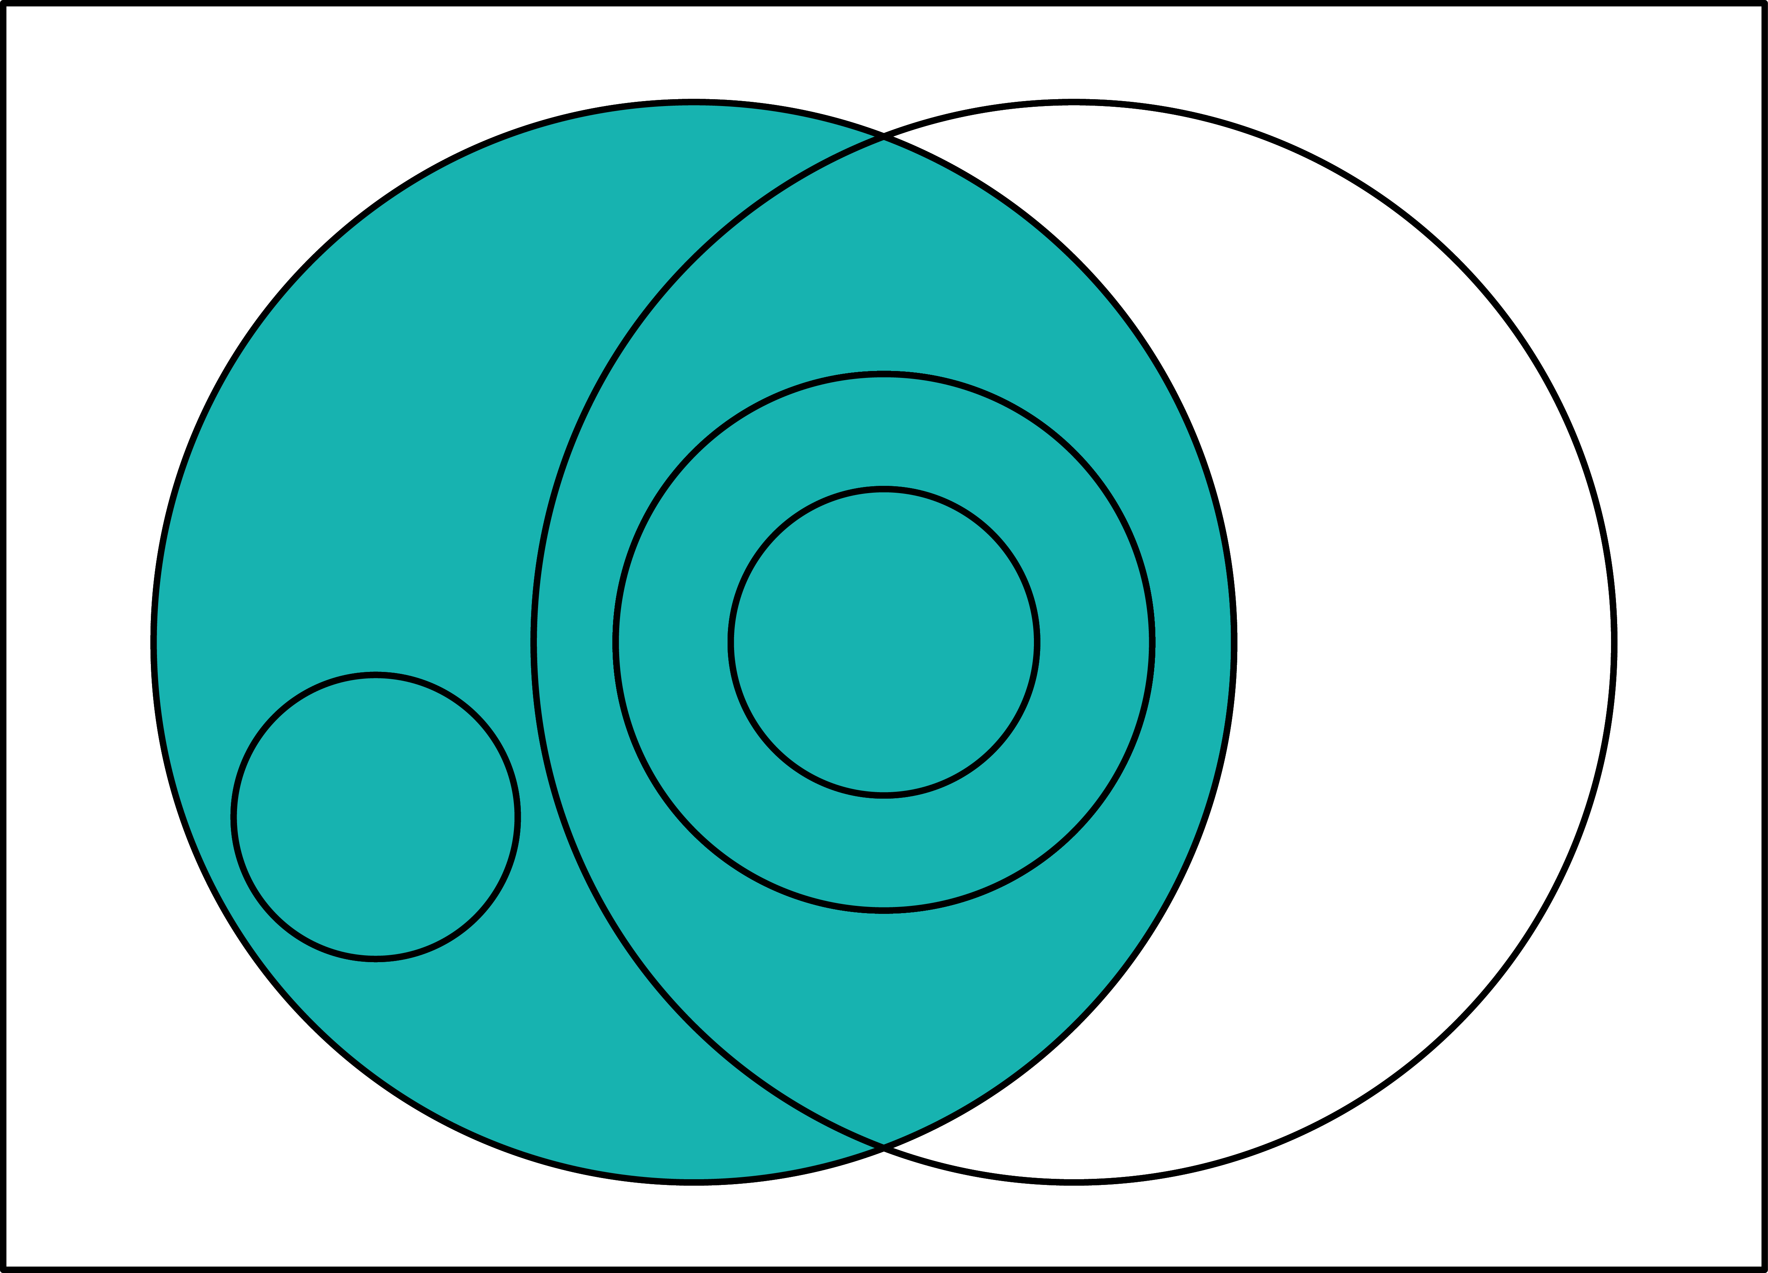
Intended Learning (by a student)

Slide 29
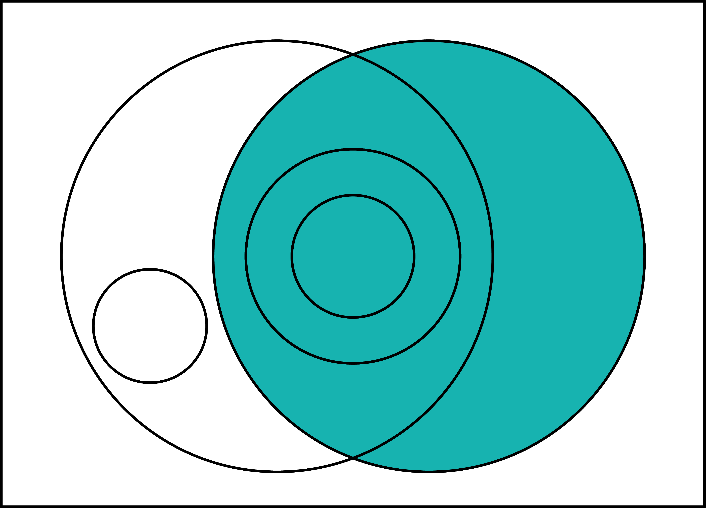
Guided Learning (by a teacher)

Slide 30
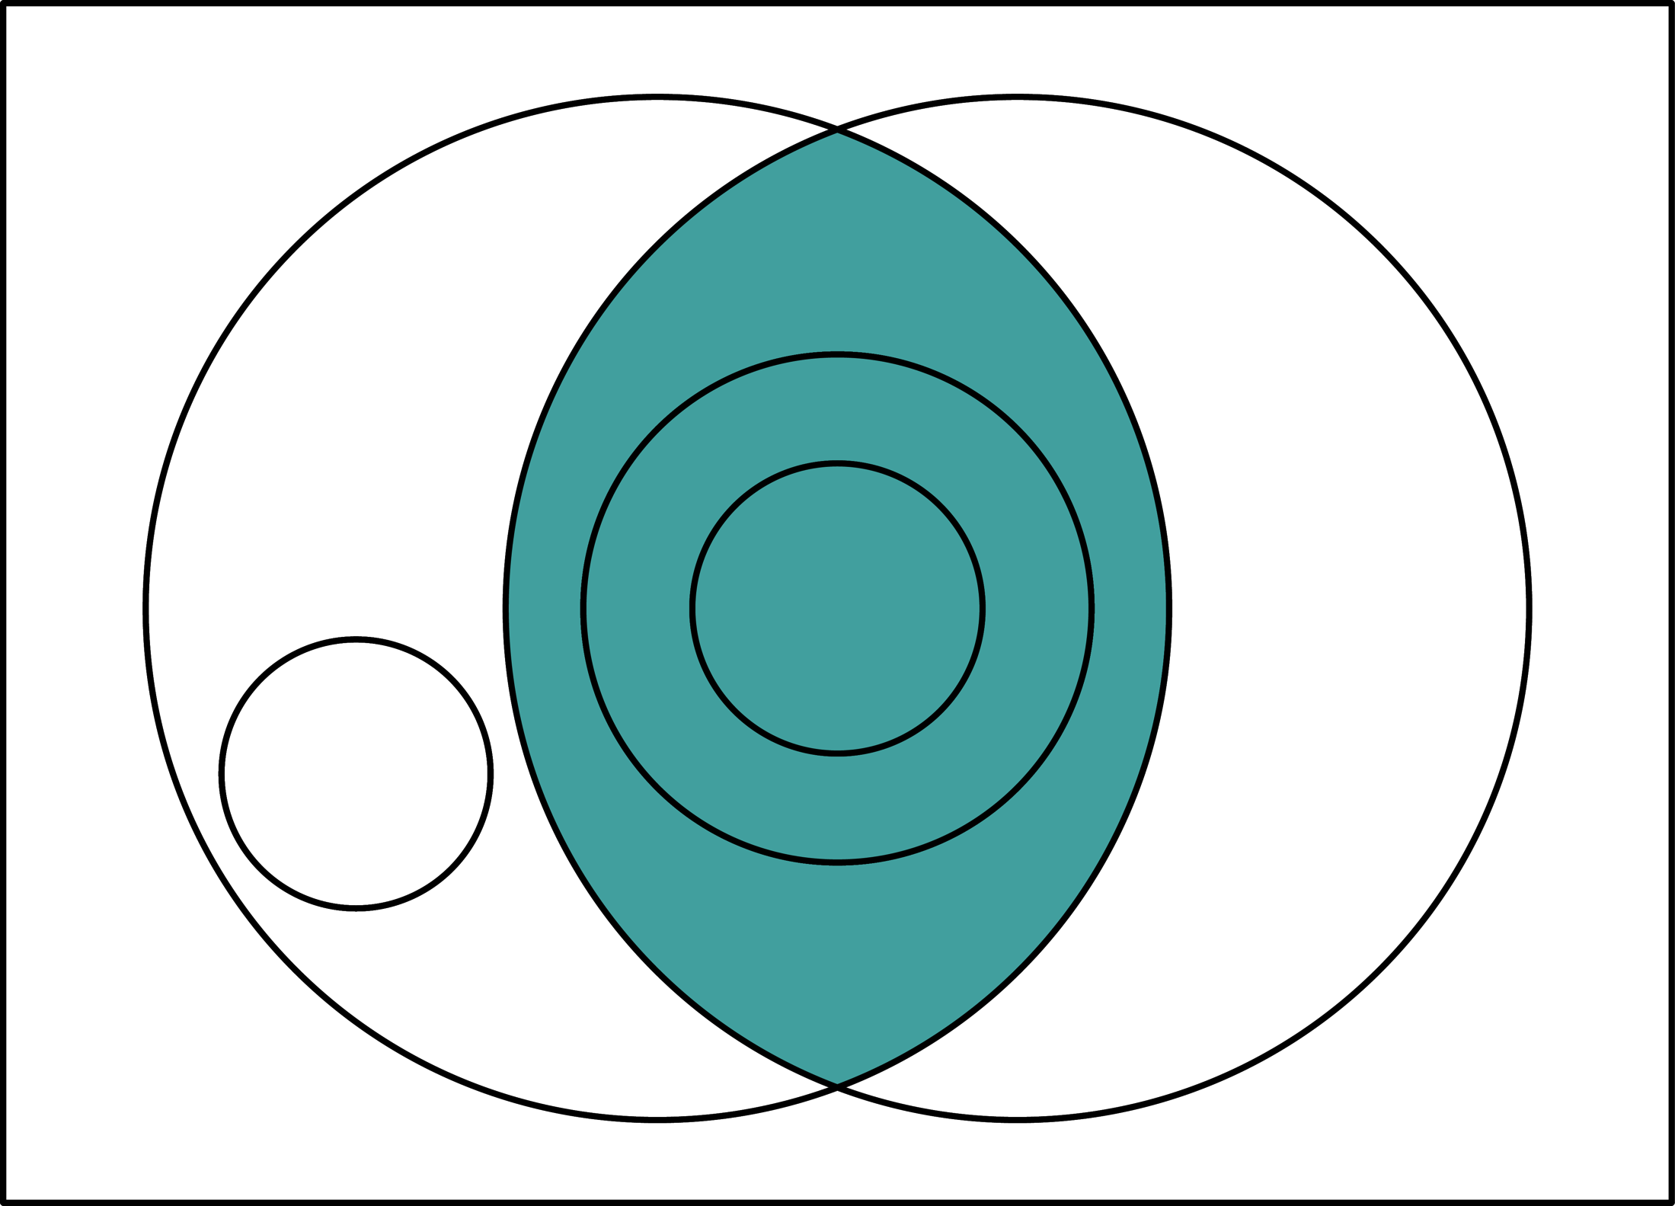
Education: intended & guided learning (Steiner, 1988)

Slide 31
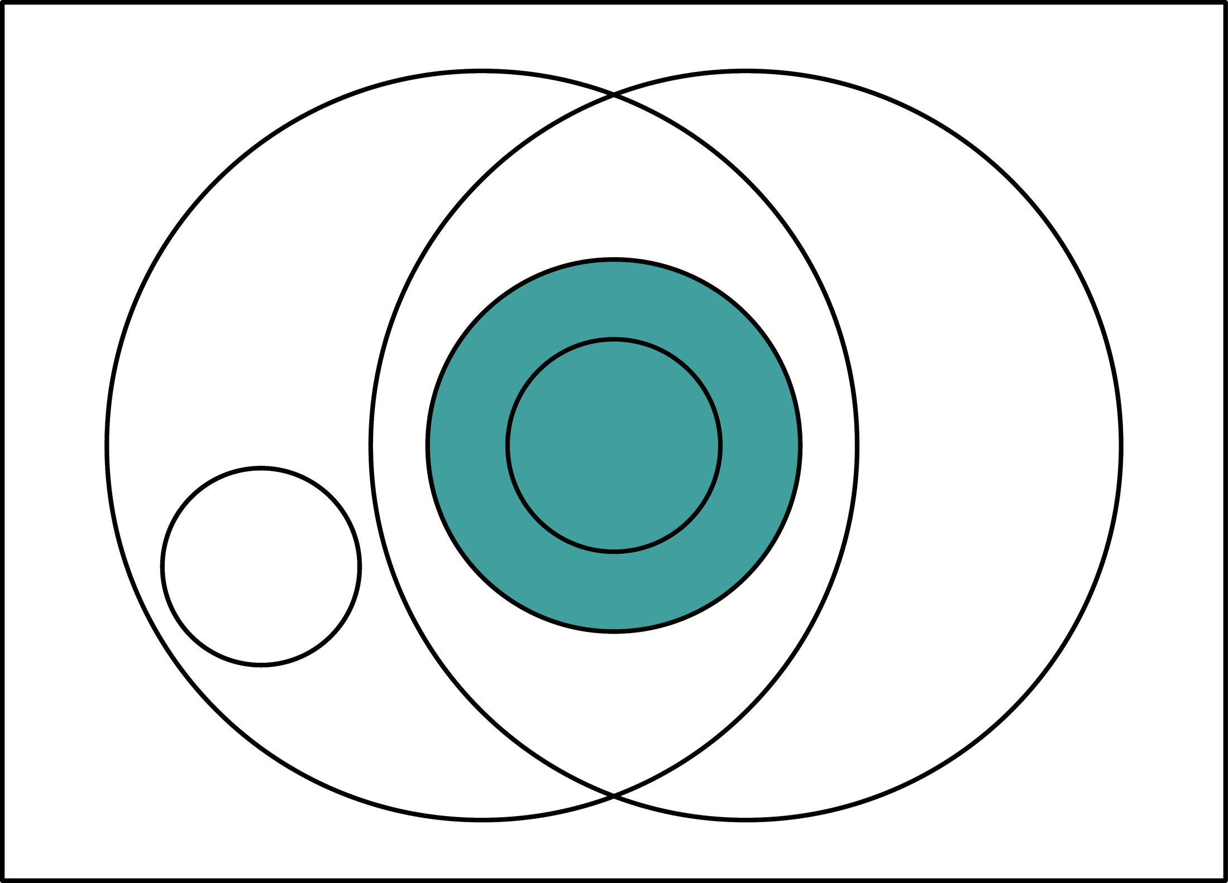
Effective Education: instrumentally good (it works—achieves desired ends or goals)

Slide 32
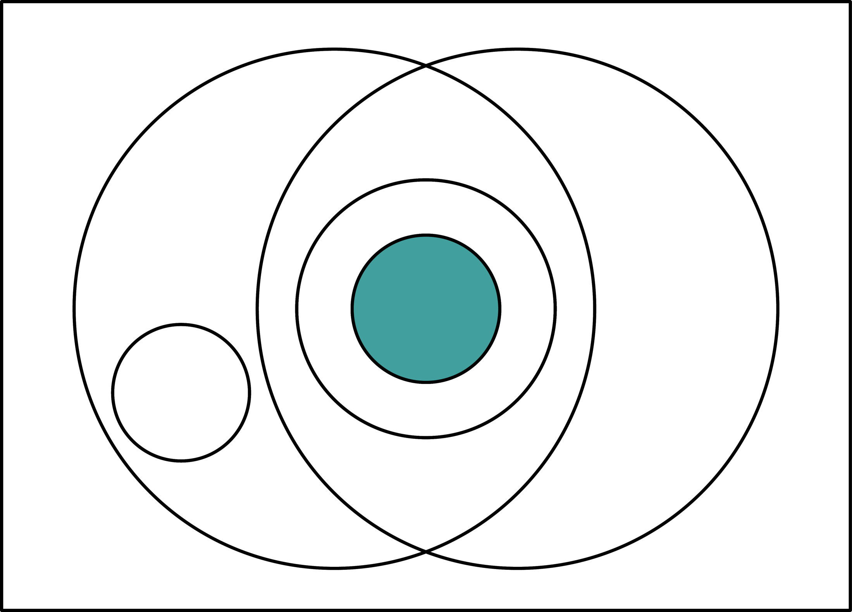
Worthwhile Education: instrumentally and intrinsically good

Slide 33
Big Picture: learning and education

Slide 34
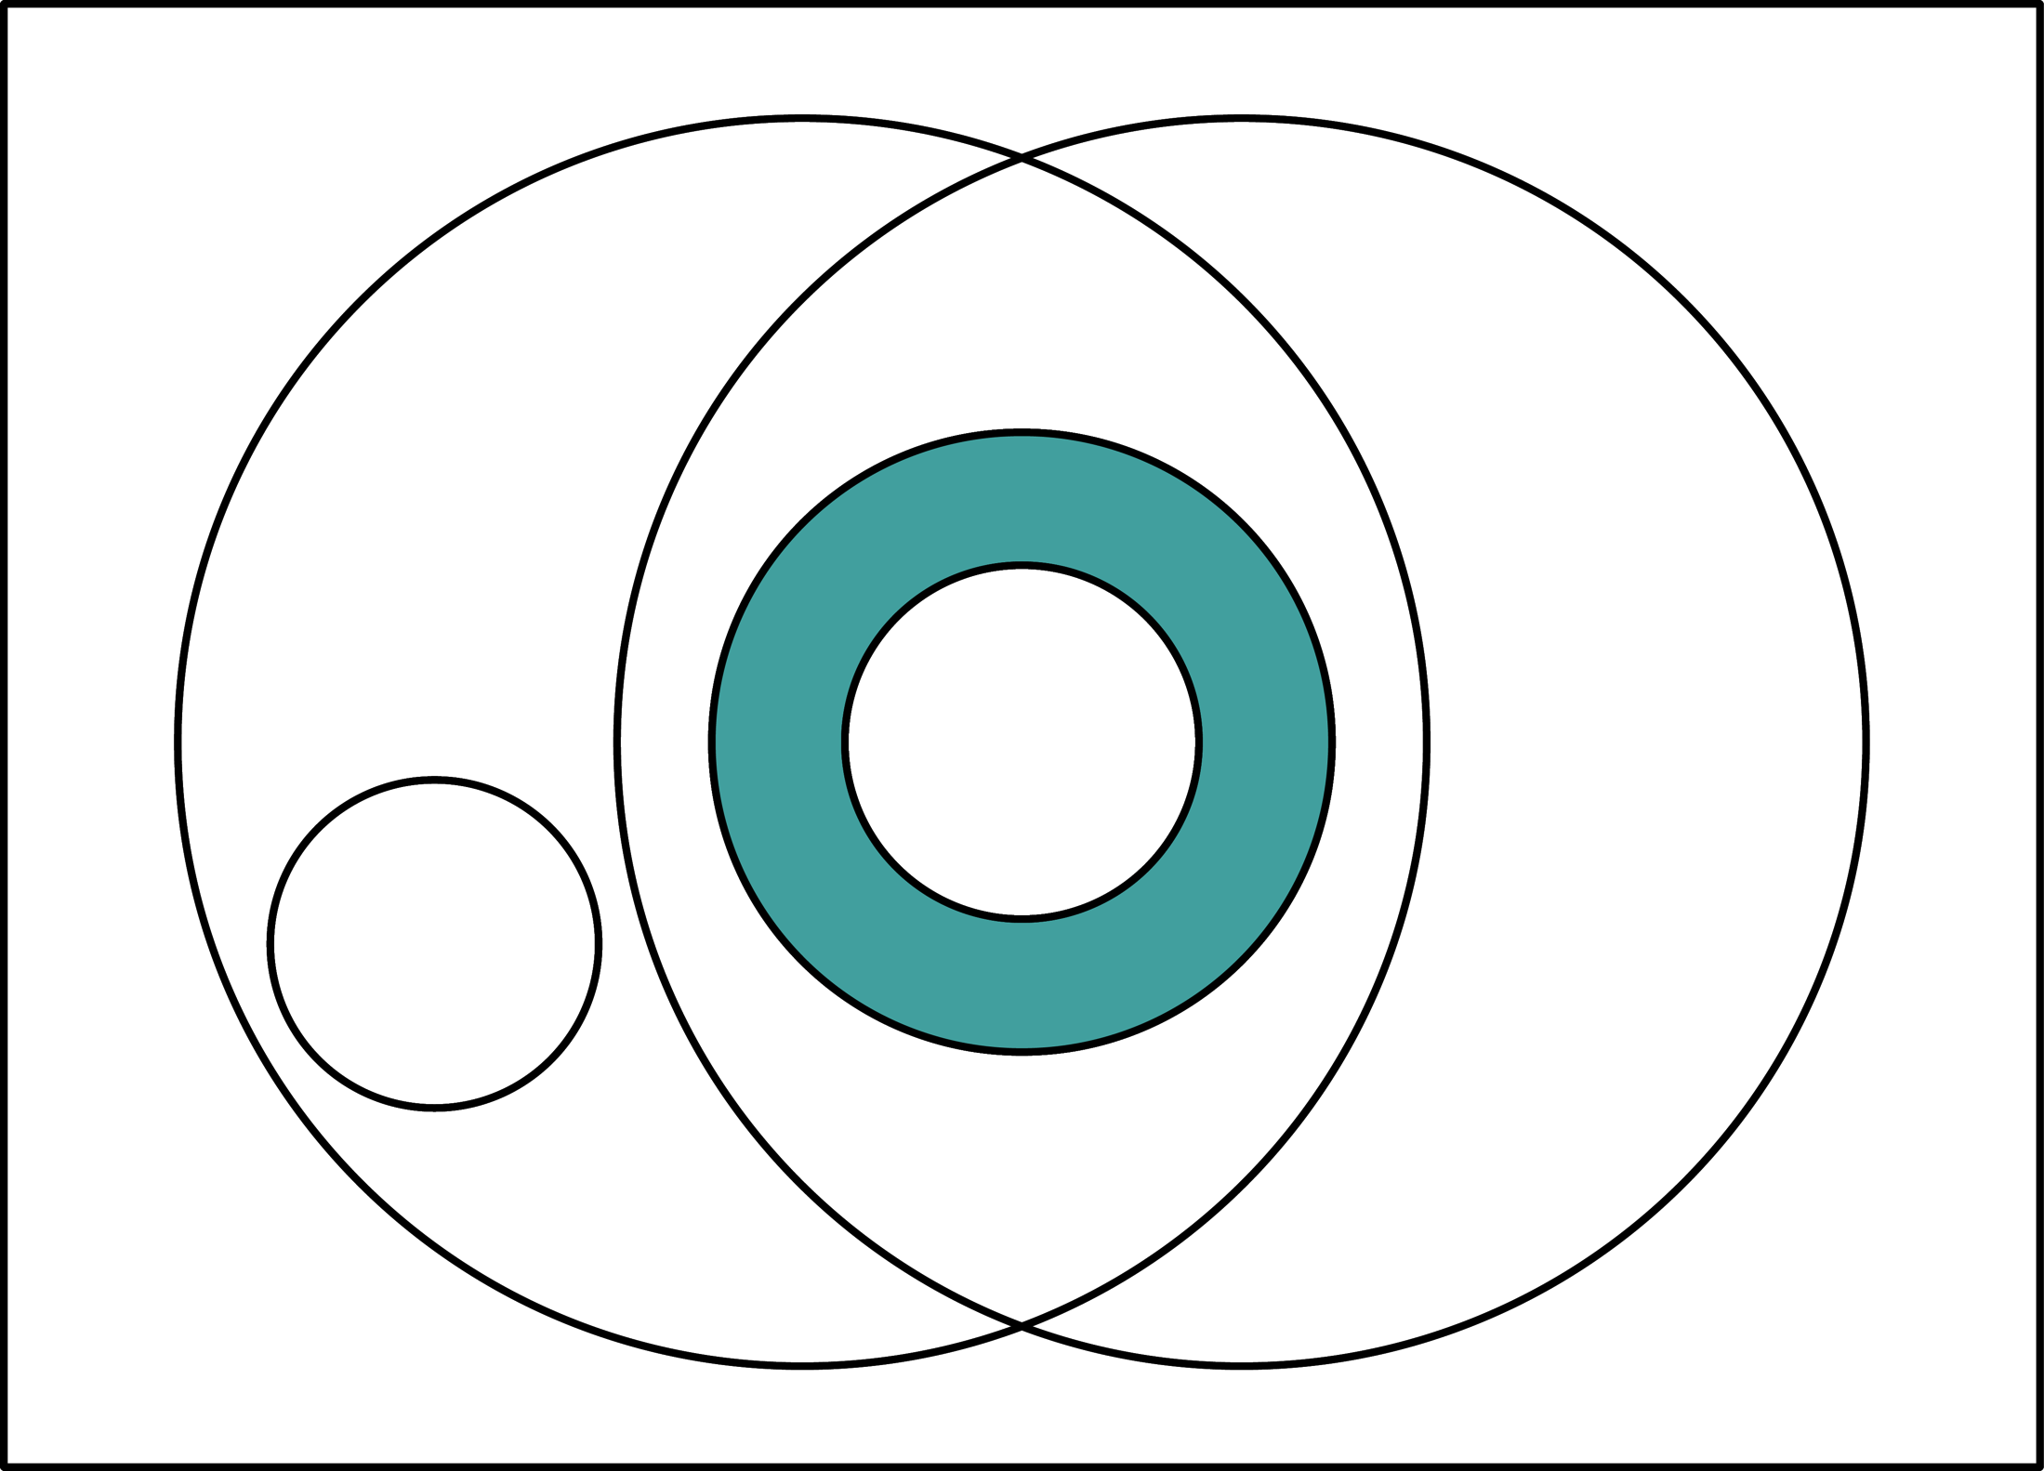
Effective education that is not worthwhile

Slide 35
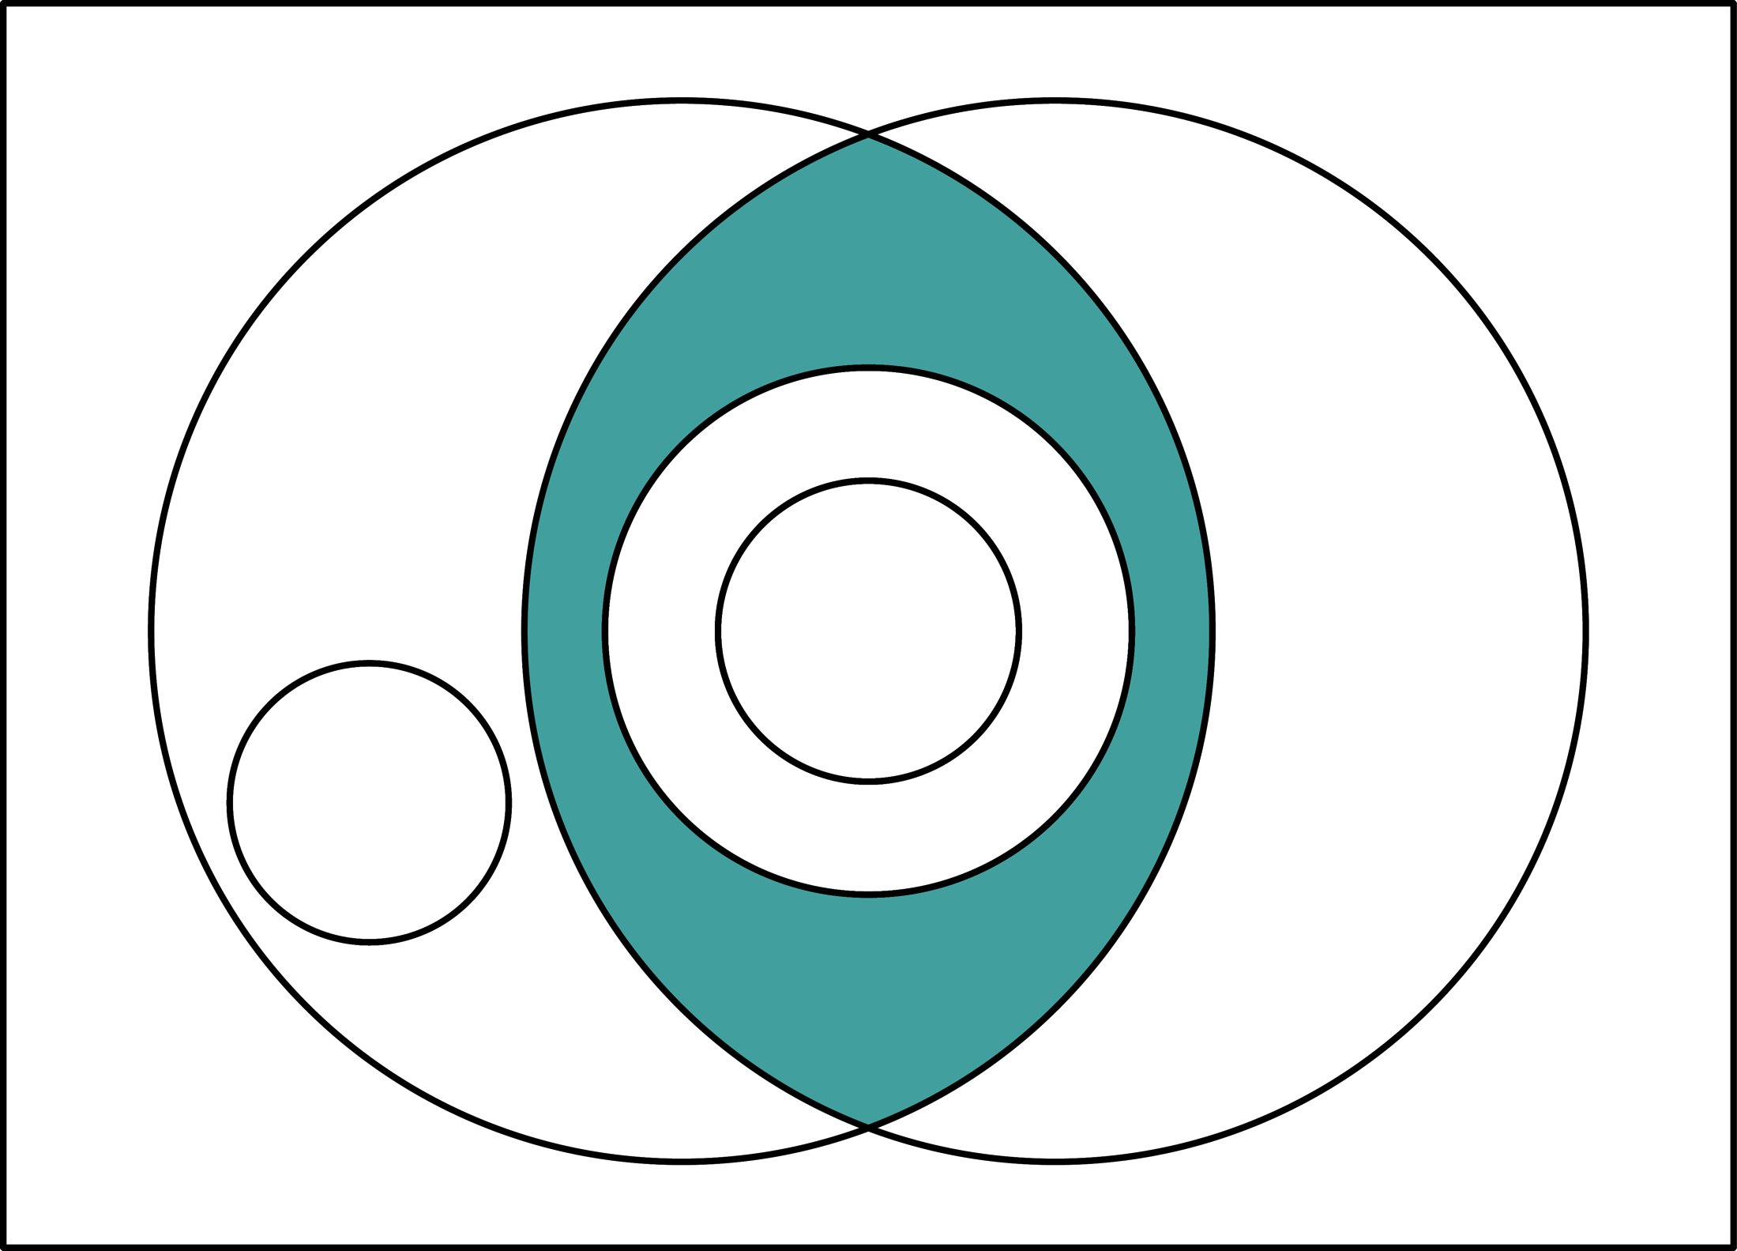
Ineffective Education

Slide 36
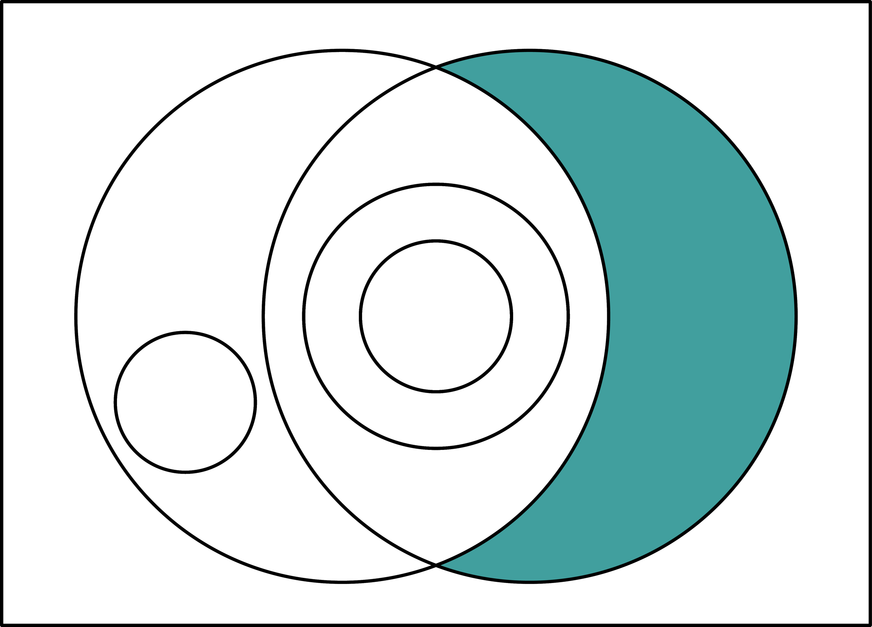
Compelled Learning: guided & not intended (what often occurs in many U.S. schools)

Slide 37
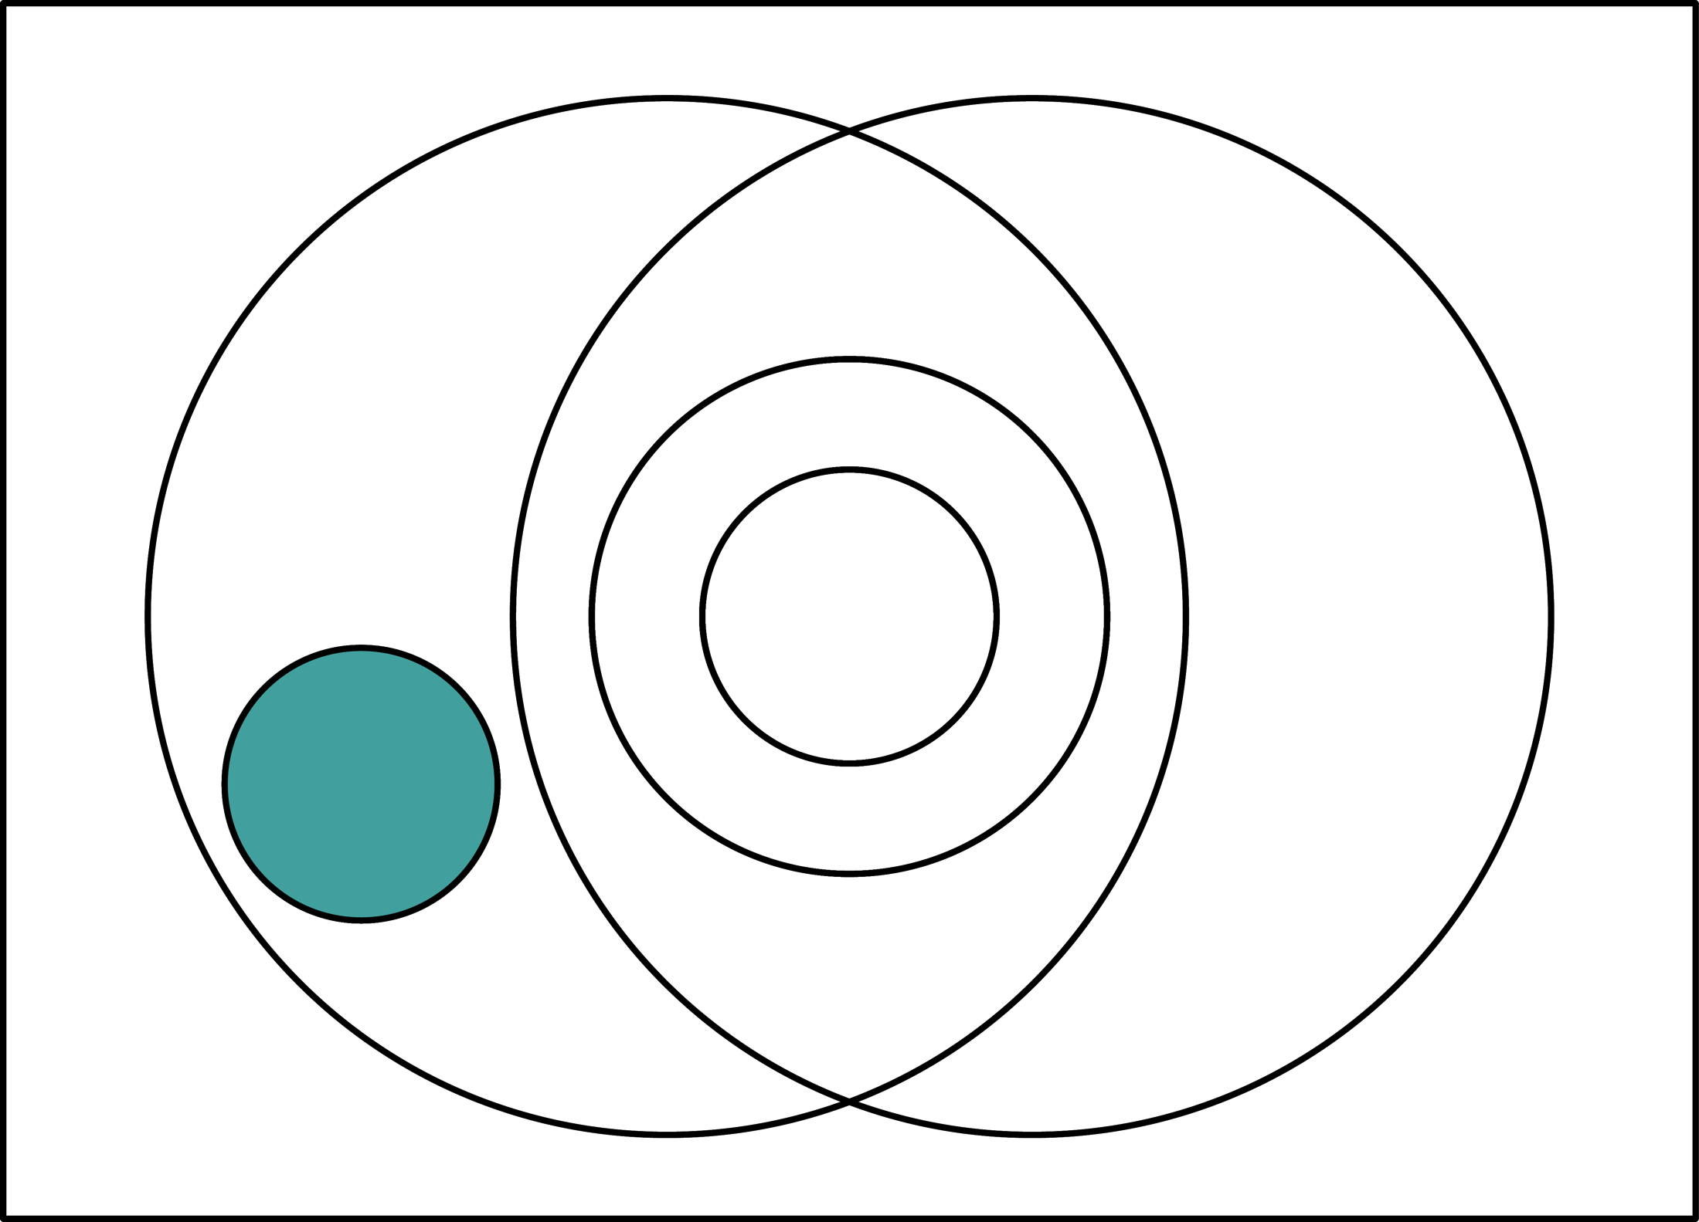
Research: Intended learning that is disciplined but unguided (by a teacher)

Slide 38
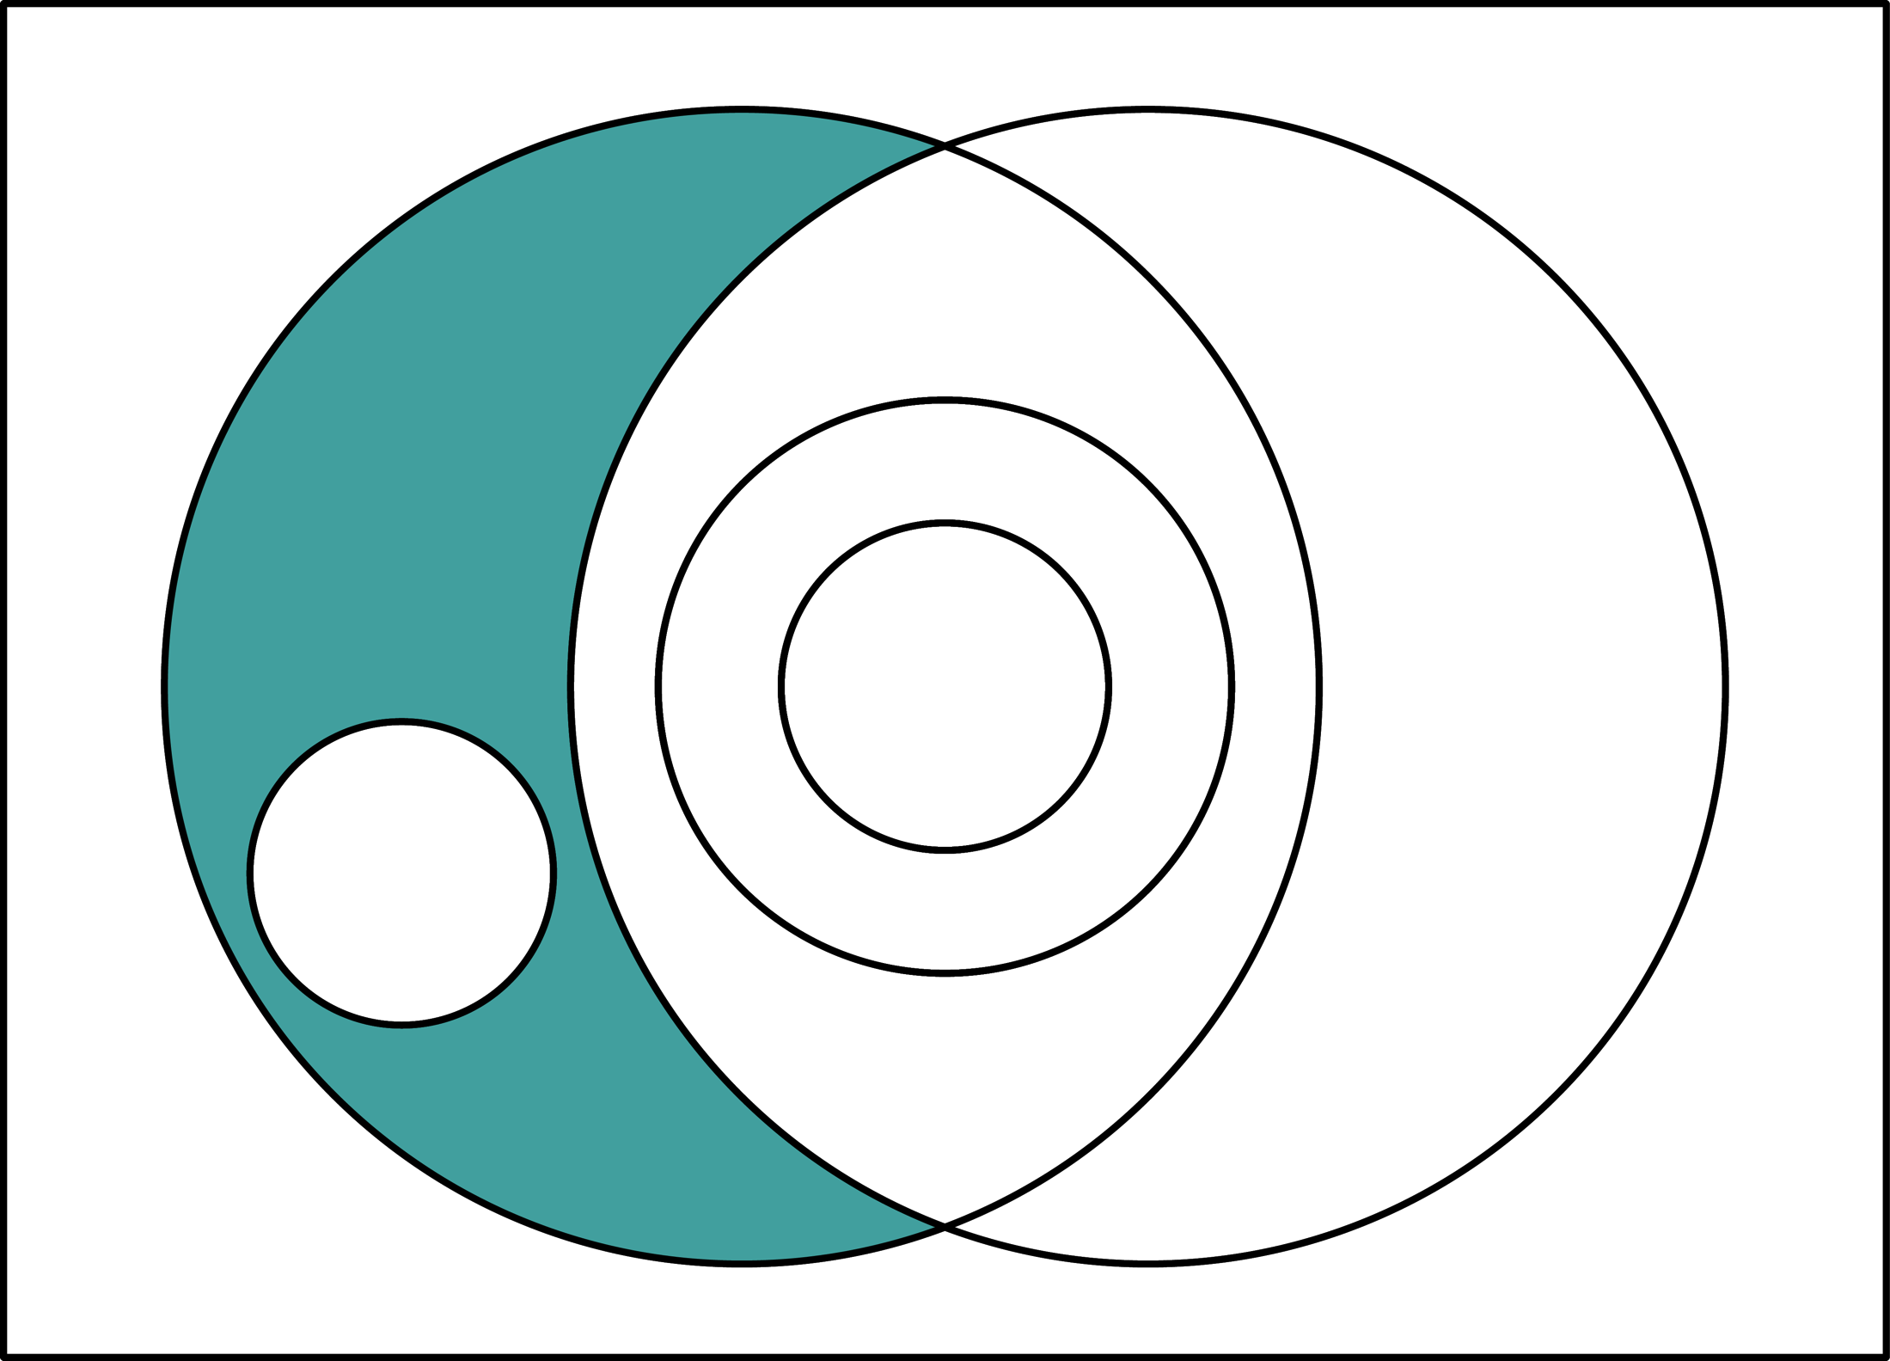
Discovery Learning: Intended learning that is undisciplined and unguided

Slide 39
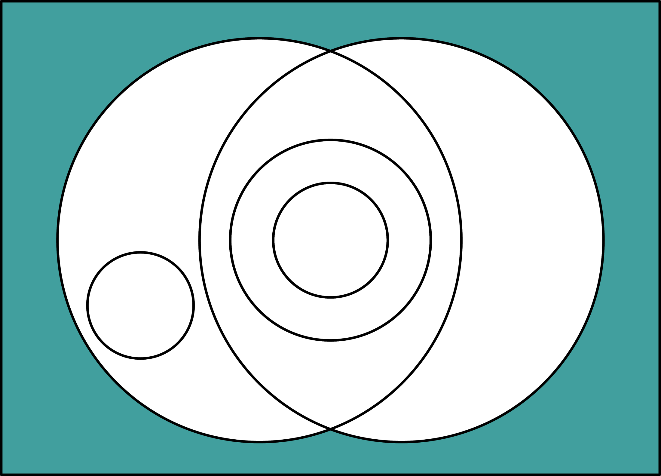
Accidental Learning: unintended and unguided

Slide 40
Big Picture: learning and education

Slide 41
Education: intended, guided learning
Steiner (1988): Education occurs when someone (teacher) intentionally guides the learning of another (student) who intends to learn something (content—X) somewhere (context)
In other words, development of intelligence occurs through education—intended, guided learning.
Education is taken broadly: teachers are not limited to those in K-12 and college instruction; students are not limited to young people; content not limited to traditional subjects; contexts not limited to schools and universities.

Slide 42
Worthwhile education is needed
Effective education occurs if attempts at intended, guided learning result in intended outcomes.
  Not all education is effective.
Worthwhile education occurs if it is instrumentally valuable and intrinsically valuable.
  Not all effective education is worthwhile.
  Worthwhile education must be intrinsically good.

Slide 43
Totally integrated education
Must be worthwhile education (i.e., it is both instrumentally and intrinsically good); and
Results in completely connected learning outcomes: cognition, intention and emotion are aligned with 9 kinds of knowing.
  Knowing that: instantial, relational & criterial
  Knowing how: imitative, adaptive & creative
  Knowing that one: recognitive, acquaintive & appreciative

Slide 44
TIE theory predicts that when cognition, intention and emotion are completely connected with 9 types of learning outcomes, then vulnerability to forgetting is minimized.

Slide 45
How can we do this?
Develop a task-centered curriculum
rather than a topic-centered curriculum

Slide 46
Examples of approaches to whole task learning
Problem-based and project-based learning
Pebble-in-the-pond approach via First Principles of Instruction (Merrill, Barclay & van Schaak, 2008)
4C/ID Model (van Merriënboer & Kirschner, 2007)
Montessori Method (cf. Lillard, 2008)
New Tech High Schools

Slide 47
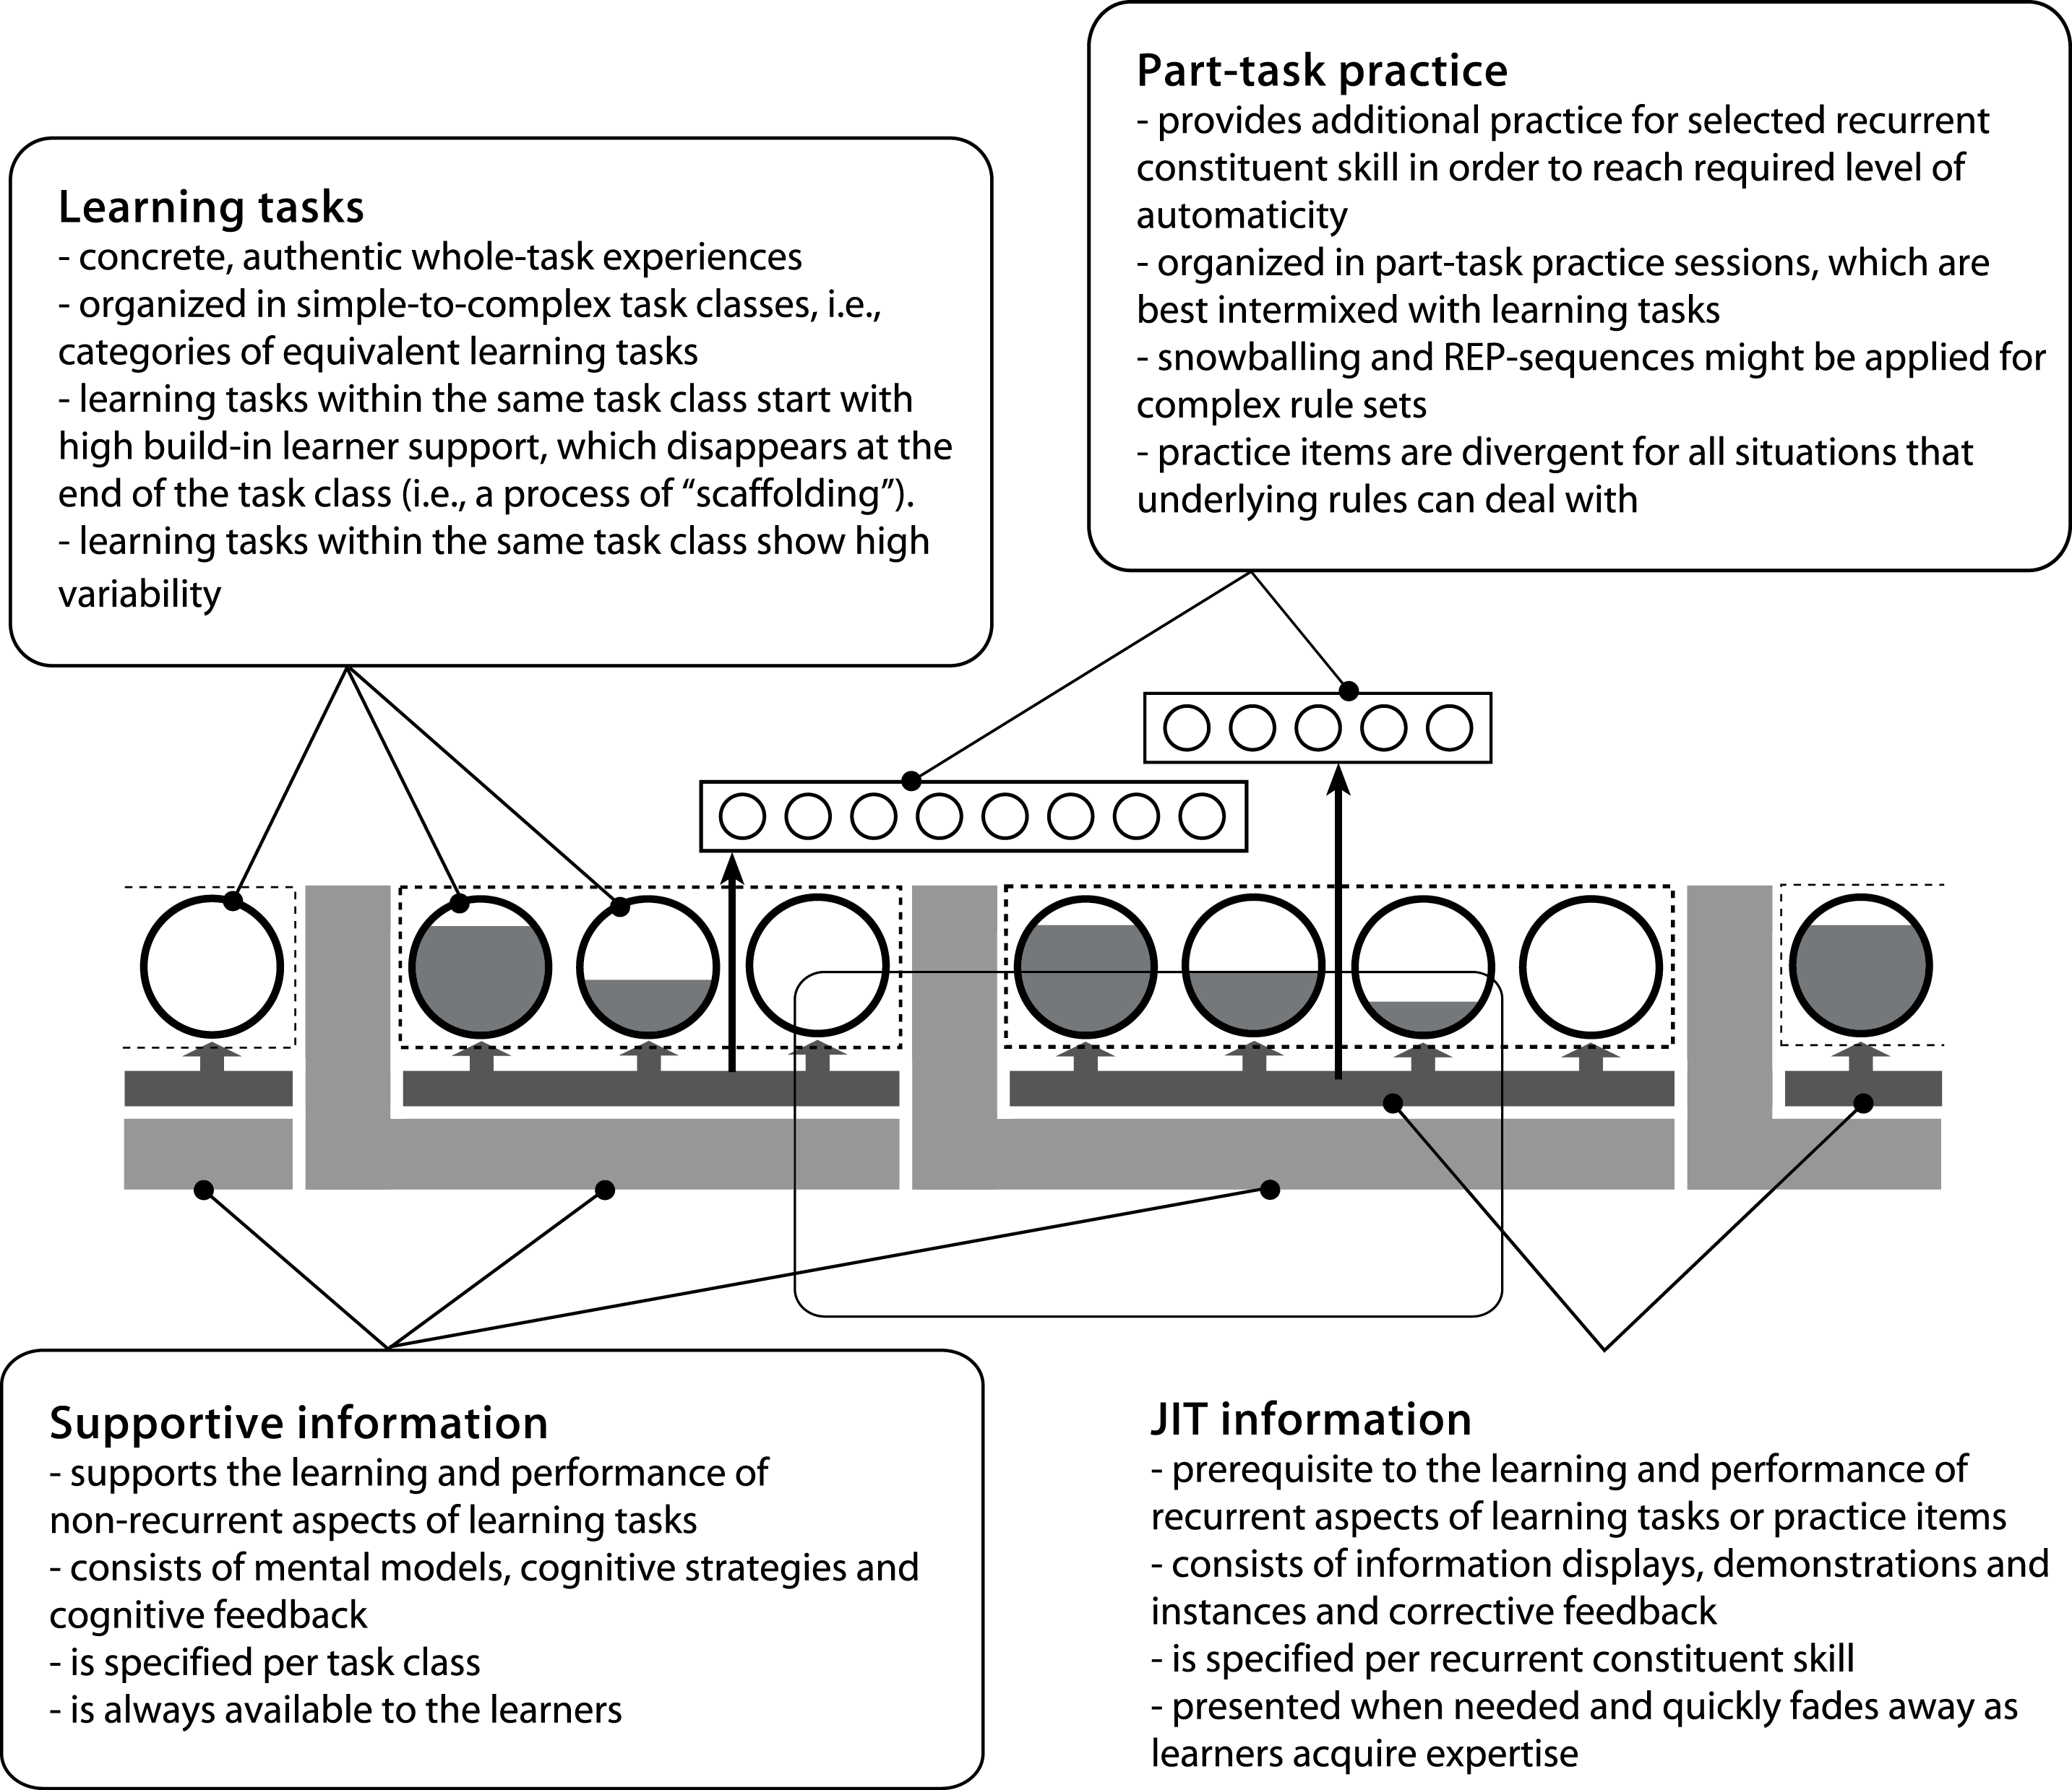
4C/ID Model (van Merriënboer & Kirschner, 2007)

Slide 48
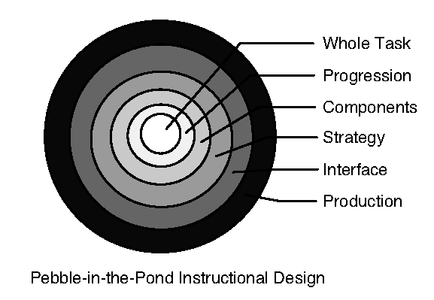
Pebble-in-the-Pond ID (Merrill, et al., 2008)

Slide 49
Implication
We need to change our curriculum from a topic-centered to a task-centered organization of learning experiences.
“Revising the curriculum and standards” is one of six common systemic change interventions observed in How the world’s most improved school systems keep getting better (Mourshed, Chijioke & Barber, 2010, p. 20)

Slide 50
Summary
When student cognition, intention and emotion are integrated with 9 types of knowing, TIE theory predicts that vulnerability to forgetting will be decreased—i.e., mental structures developed within students are more likely to remain whole because they are stronger and more flexible.
This has been but a brief overview of TIE theory.
A monograph is online which explains TIE theory in greater depth at:
  http://educology.indiana.edu/Frick/TIEtheory.pdf

Slide 51
Development of TIE theory
TIE theory has been retroduced from:
  Theory of signs (C. S. Peirce, 1932; T. L. Short, 2007)
  Epistemology of cognitive educational objectives (G. S. Maccia, 1987)
  Theory of education, methodology of theory construction (E. Steiner, 1988)
  General system theory (L. von Bertalanffy, 1950; Maccia & Maccia, 1966; Thompson, 2006)
Retroduction
  New theory is devised by using other extant theory as models from which ideas are taken (C. S. Peirce, 1877; Steiner, 1988)
  Retroduction contrasts with deduction (for explicating theory) and induction (for verifying theory)

Slide 52
Acknowledgment
Thanks to Colin Gray for creating the graphics in this presentation, and to Elizabeth Boling for drawings that illustrate basic kinds of knowing.

Slide 53
References
Bateson, G. (1979). Mind and nature. New York, NY: E. P. Dutton.
Brown, D. G. (1970). Knowing how and knowing that, what. In G. Pitcher and O. Wood (Eds.), Ryle: A Collection of critical essays (pp. 213-248). Garden City, NY: Doubleday.
Cornford, F. M. (translator, 1945). The Republic of Plato. New York, NY: Oxford University Press.
Dewey, J. (1916). Democracy and education. New York, NY: The Free Press.
Estep, M. (2006). Self-organizing natural intelligence: Issues of knowing, meaning and complexity. Dordrecht, The Netherlands: Springer.
Frick, T. W. (1997). Artificially intelligent tutoring systems: What computers can and can’t know. Journal of Educational Computing Research, 16(2), 107-124.
Geach, P. (1964). Mental acts. New York, NY: The Humanistic Press.
Gore, A. (2006). An inconvenient truth. New York, NY: Rodale Books.
Greenspan, S. I. & Benderly, B. L. (1997). The growth of the mind and the endangered origins of intelligence. Reading, MA: Addison-Wesley.
Greenspan, S. I. & Shanker, S. G. (2004). The first idea: How symbols, language, and intelligence evolved from our primate ancestors to modern humans. Cambridge, MA: Da Capo Press (Kindle edition).
Goleman, D. (2011). The brain and emotional intelligence: New insights (Kindle Ed.). Northhampton, MA: More Than Sound LLC.
Henneberg, M. (1998). Evolution of the human brain: Is bigger better? Clinical and Experimental Pharmacology and Physiology, 25(9), 745-749.
Kandel, E. R. (1989). Genes, nerve cells, and the remembrance of things past. Journal of Neuropsychiatry, 1(2), 103-125.
Kandel, E. R. (2001). The molecular biology of memory storage: A dialogue between genes and synapses. Science, 294, 1030-1038.
Kant, E. (1785). Grounding for the metaphysics of morals: On a supposed right to lie because of philanthropic concerns (Translated by J. W. Ellington, 1993). Indianapolis, IN: Hackett Publishing.

Slide 54
References (cont’d)
Lillard, A. S. (2008). Montessori: The science behind the genius. New York: Oxford University Press.
Maccia, G. S. (1986). Right opinion and Peirce’s theory of signs. Paper presented at the Semiotic Studies Faculty Seminar. Retrieved July 17, 2011, from: http://educology.indiana.edu/Maccia/RightOpinionAndPeircesTheoryOfSigns_GSMaccia1987.pdf.
Maccia, G. S. (1987). Genetic epistemology of intelligent natural systems. Systems Research, 4(3), 213-218. Retrieved July 17, 2011, from: http://educology.indiana.edu/Maccia/Correspondence_GeneticEpistemologyOfIntelligentNaturalSystems1987.pdf.
Maccia, G. S. (1988). Genetic epistemology of intelligent natural systems: Propositional, procedural and performative intelligence. Paper presented at Hangzhou University, China. Retrieved July 17, 2011, from: http://educology.indiana.edu/Maccia/GeneticEpistemologyOfIntelligentSystems_propositionalProceduralPerformativeIntelligence1988.pdf.
Merrill, M. D., Barclay, M., & van Schaak, A. (2008). Prescriptive principles for instructional design. In J. M. Spector, M. D. Merrill, J. van Merriënboer, & M. F. Driscoll (Eds.), Handbook of research on educational communications and technology (3rd ed., pp. 173–184). New York: Lawrence Erlbaum Associates.
Mendenhall, A., Buhanan, C. W., Suhaka, M., Mills, G., Gibson, G. V., & Merrill, M. D. (2006). A task-centered approach to entrepreneurship. Tech Trends, 50(4), 84-89.
Molenda, M., & Rice, J.M. (1979). Simulation review: The Diffusion Simulation Game. Produced and distributed by the University Consortium for Instructional Development and Technology (UCIDT). Simulation and Games, 10(4), 459-467.
Mourshed, M., Chijioke, C. & Barber, M. (2010). How the world’s most improved school systems keep getting better. London: McKinsey & Co. Retrieved July 22, 2010, from: http://ssomckinsey.darbyfilms.com/reports/schools/How-the-Worlds-Most-Improved-School-Systems-Keep-Getting-Better_Download-version_Final.pdf.
New Tech Network (n.d.). Retrieved July 17, 2011, from: http://www.newtechnetwork.org/.
Peirce, C. S. (1877). The fixation of belief. In J. Buchler (Ed.), The philosophic writings of Peirce. New York: Dover Publications, 1955, 5-22.
Peirce, C. S. (1931). Collected papers, Vol. I, Principles of philosophy (C. Hartshorne & P. Weiss, Eds.). Cambridge, MA: Harvard University Press.
Peirce, C. S. (1932). Collected papers, Vol. II, Elements of logic (C. Hartshorne & P. Weiss, Eds.). Cambridge, MA: Harvard University Press.

Slide 55
References (cont’d)
Peirce, C. S. (1934). Collected papers, Vol. V, Pragmatism and pragmaticism (C. Hartshorne & P. Weiss, Eds.). Cambridge, MA: Harvard University Press.
Ryle, G. (1959). The concept of mind. New York, NY: Barnes and Noble.
Scheffler, I. (1965). Conditions of knowledge. Glenview, IL: Scott-Foresman.
Semmelweis, I. P. (2008). In Encyclopædia Britannica. Retrieved March 12, 2008, from Encyclopædia Britannica Online: http://search.eb.com/eb/article-9066723.
Short, T. L. (2007). Peirce’s theory of signs. New York, NY: Cambridge University Press.
Squire, L. R. & Kandel, E. R. (1999). Memory: From mind to molecules. New York, NY: Henry Holt and Co.
Steiner, E. (1988). Methodology of theory building. Sydney: Educology Research Associates.
Steiner, E. (2009). Ethical theory (Lecture notes). Retrieved July 14, 2011, from https://www.indiana.edu/~tedfrick/steiner/Ethical%20Theory.pdf .
Thompson, K. R. (2006a). “General system” defined for predictive technologies of A-GSBT (Axiomatic General Systems Behavioral Theory). Scientific Inquiry Journal, 7(1), 1-11.
Thompson, K. R. (2006b). Axiomatic theories of intentional systems: Methodology of theory construction. Scientific Inquiry Journal, 7(1), 13-24.
Thompson, K. R. (2008a). ATIS glossary. Retrieved July 14, 2011, from http://www.indiana.edu/~aptac/glossary/.
Thompson, K. R. (2008b). ATIS graph theory. Columbus, OH: Systems Predictive Technologies. Retrieved from: https://www.indiana.edu/~aptfrick/overview/reports/11ATISgraphtheory.pdf.
van Merriënboer, J. J., Kirschner, P.A., & Kester, L. (2003). Taking the load off a learner’s mind: Instructional design for complex learning. Educational Psychologist, 38(1), 5-13.
van Merriënboer, J. J. & Kirschner, P.A. (2007). Ten steps to complex learning: A systematic approach to four-component instructional design. Mahwah, NJ: Lawrence Erlbaum Associates.
Vreeman, R. & Greene, G. (2007). Medical myths even doctors believe. British Medical Journal, 335(7633), 1288-1289.
Yazzie-Mintz, , E. (2007). Voices of students on engagement: A report on the 2006 high school survey of student engagement. Retrieved July 14, 2011, from http://www.eric.ed.gov/PDFS/ED495758.pdf.

